Slide 1
The Product Company: Final Data Mart Development Report
Team: 1
Members: Geeta Madhav Gali, Sai Venkat Kotha, Sanjay Varma Rudraraju

Slide 2
Universe of Discourse:
This data mart can be used by the management of the company to investigate the Financial performance at the gross profit level.

Slide 3
Grain
An individual transaction which represents the sale of a product to a customer on a specific day

Slide 4
Dimensions
Customer
Product
Sale date
Order date
Sale order attributes

Slide 5
Fact
Sale Details
amount
quantity
discounted
division
In voice

Slide 6
Junk and Degenerate Dimensions
Junk Dimension
Sale order attributes
Shipping Method
Order Method
Payment Method
Degenerate Dimension
In voice

Slide 7
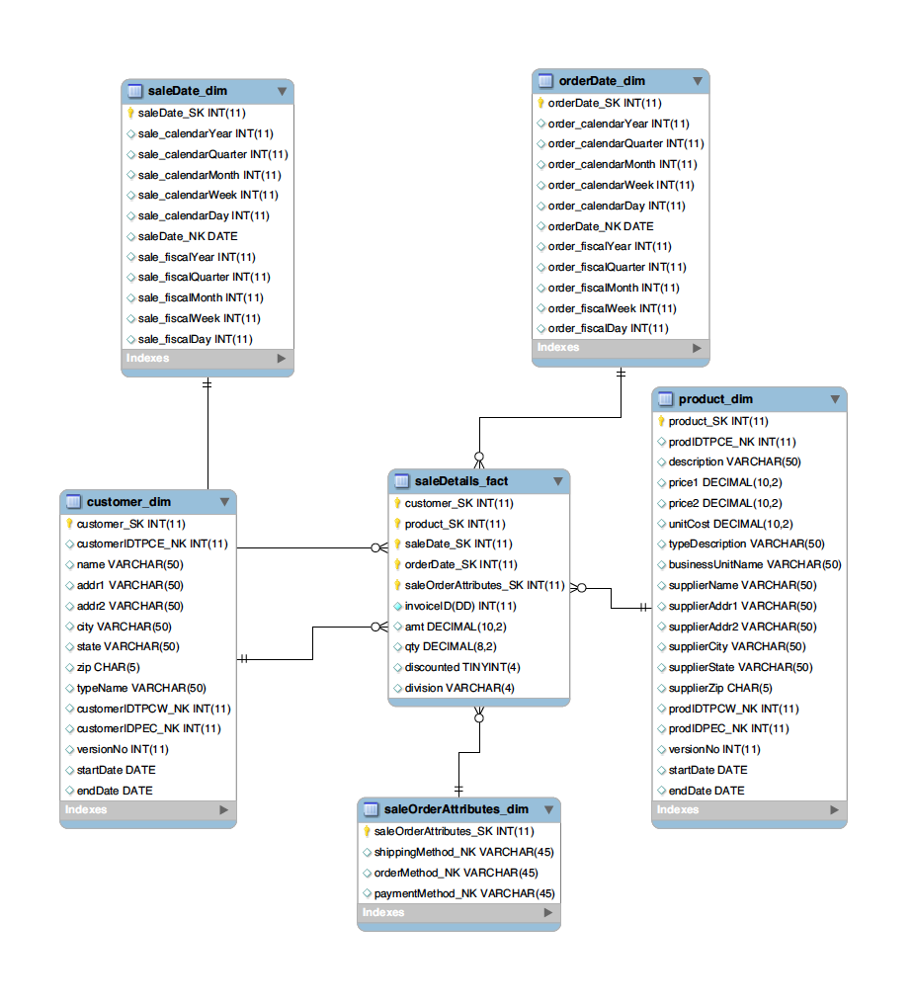
ER Model

Slide 8
Data Cleaning
Customer
Standardizing company extensions
Standardizing the Customer Type Name
Standardizing Address (addr1, addr2 and State)
Correcting the zipcodes
Removing unnecessary punctuation in address
Streamlining CustomerID

Slide 9
Data Cleaning
Product
Standardizing Supplier Name
Standardizing the Description, Type Description and Business unit name
Standardizing Address (addr1, addr2 and State)
Correcting the zipcodes
Removing unnecessary punctuation in address
Streamlining CustomerID

